Slide 1

Documentation of GeoJournal Application
By:
Vivek Dantu
Tanvi Magdum

Slide 2
GitHub Repo Link
https://github.com/tanvimagdum/NU_MAD_SP2023_Final_Project_15.git

Slide 3
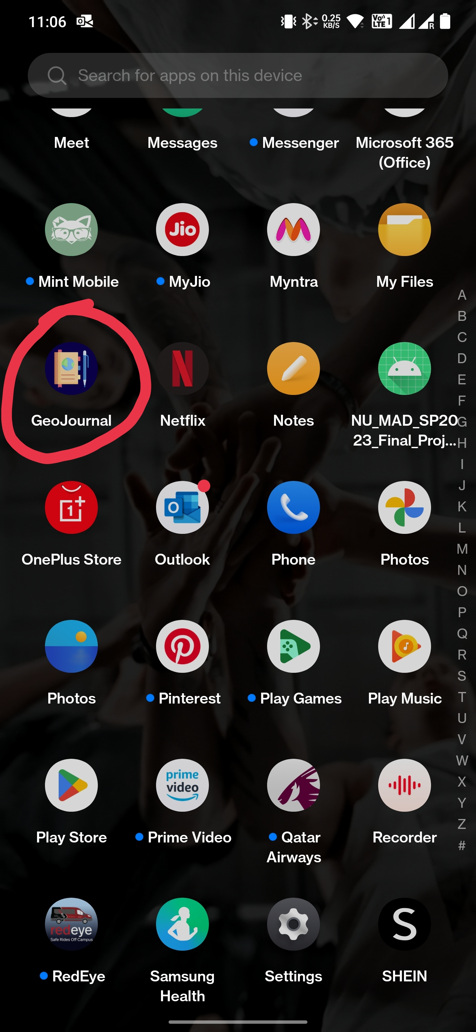
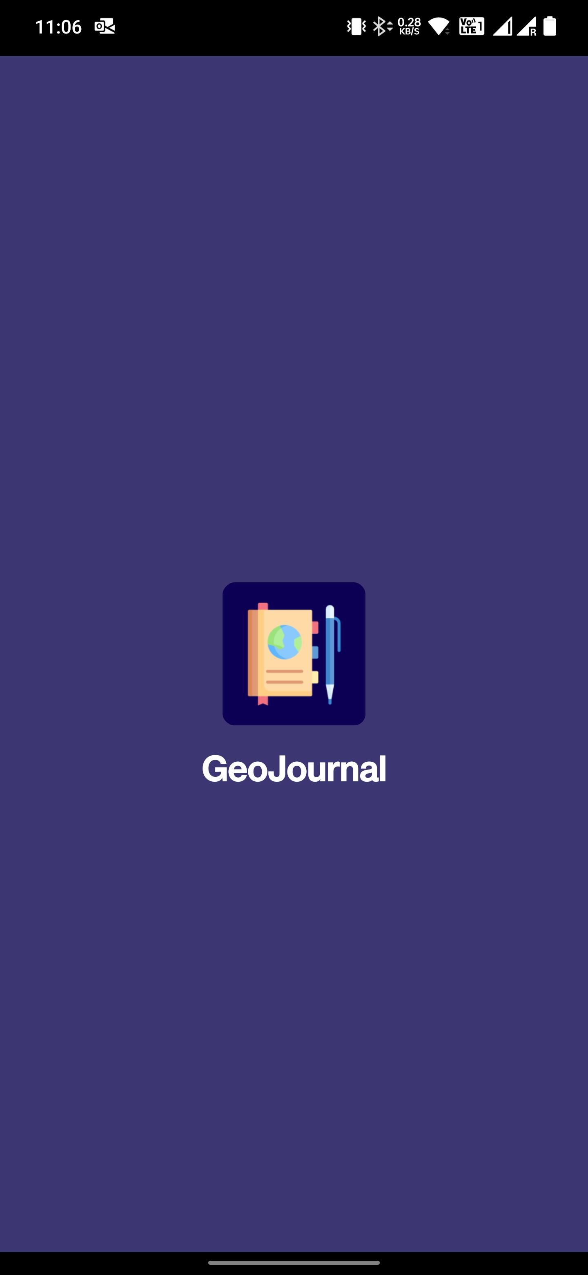
Application Launcher

Slide 4
Application Launcher
We have included an icon (mipmap) for our application which is titled “GeoJournal”. The app transition is made smoother here.
When the user clicks on the icon, the application is launched showing its logo and a cool background.

Slide 5
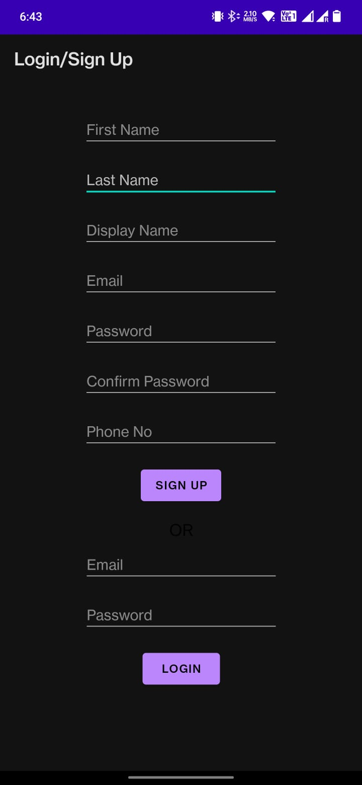
Login and Sign Up

Slide 6
Login and Sign Up
This page lets the user to sign up or login into the application.
User is required to use unique email address for each account.
Email Ids are non-modifiable.

Slide 7
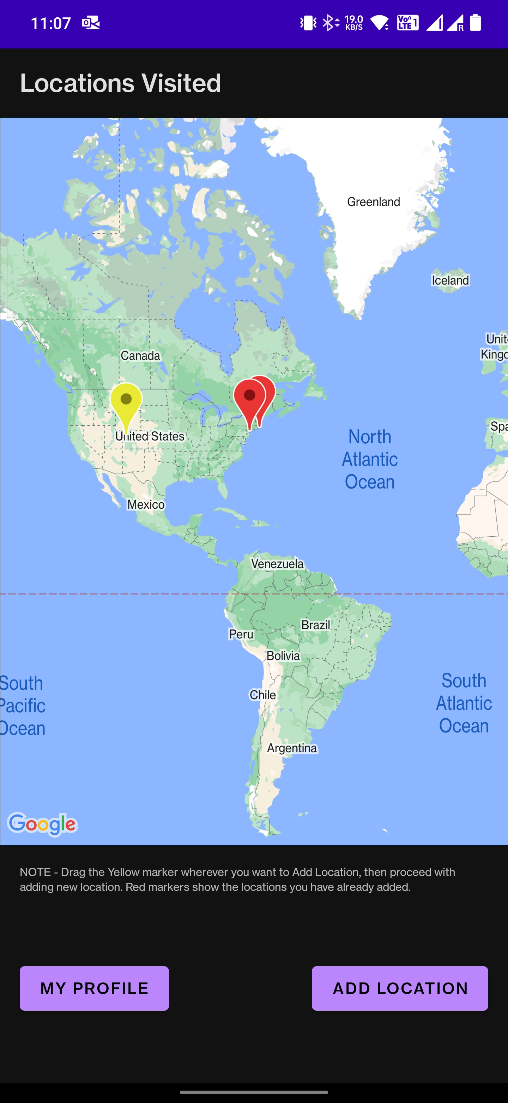
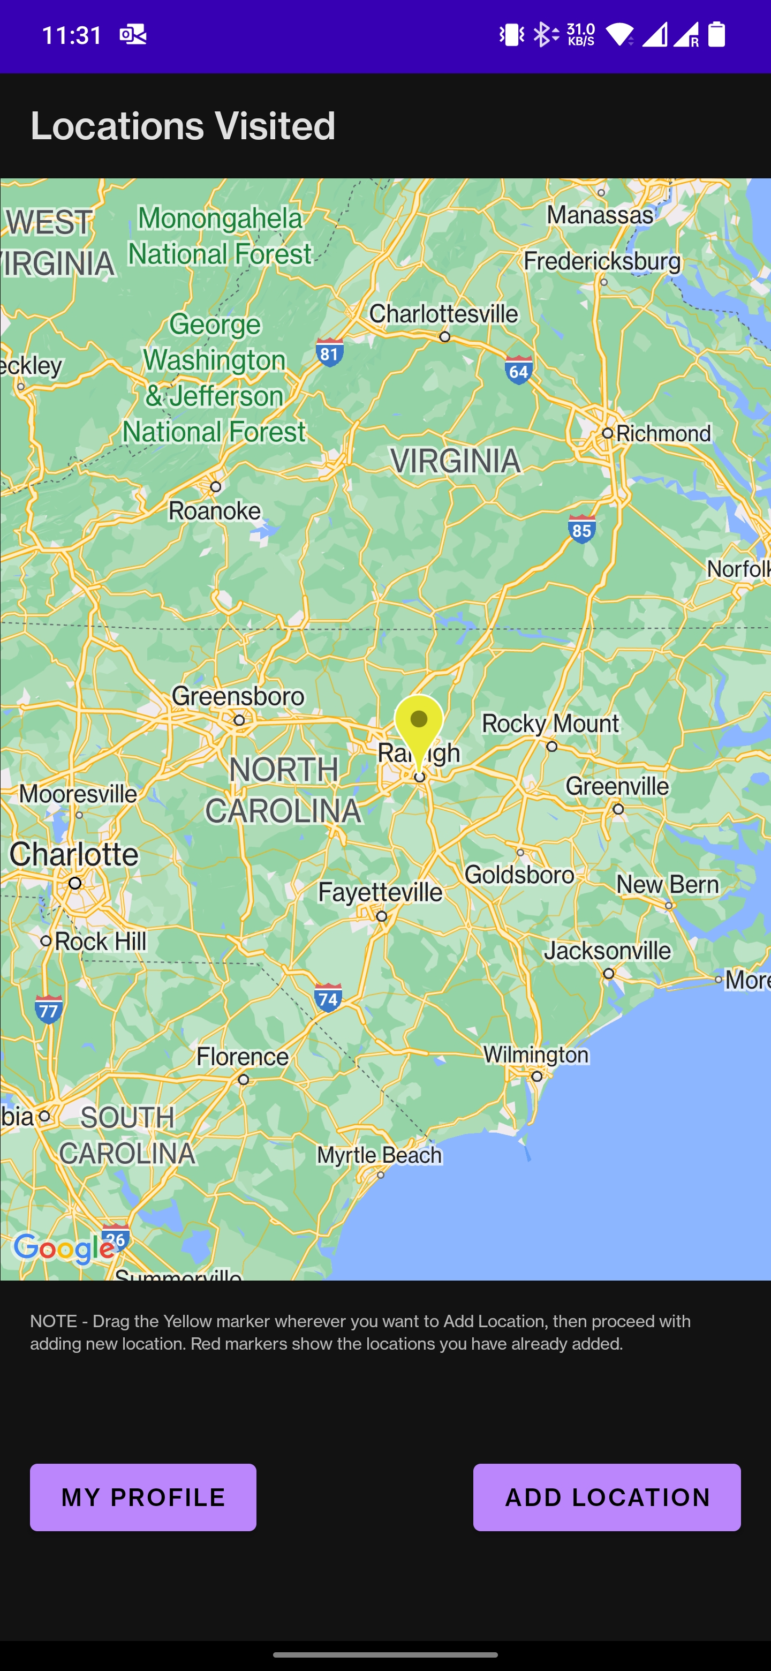
Landing Page

Slide 8
Landing Page
As soon as the user logs in or signs up a landing page similar to that shown in the screenshot will be displayed.
A single yellow marker is a draggable marker which user can drag to a specific location in the world map and tag info regarding it.
Red markers may or may not be present depending on the user who have already added locations.
Red markers are clickable but non-draggable. Clicking on a Red marker would display the information that has been tagged to it.

Slide 9
Landing Page
My Profile button on this page will give access to changing or viewing the user profile.
Add location button takes you to a flow of activities where user can add information about the place. User has to drag the yellow marker to the traveled place before clicking the Add Location button. User can zoom into the map to find the exact location, thus making sure it is the right place to tag information.

Slide 10
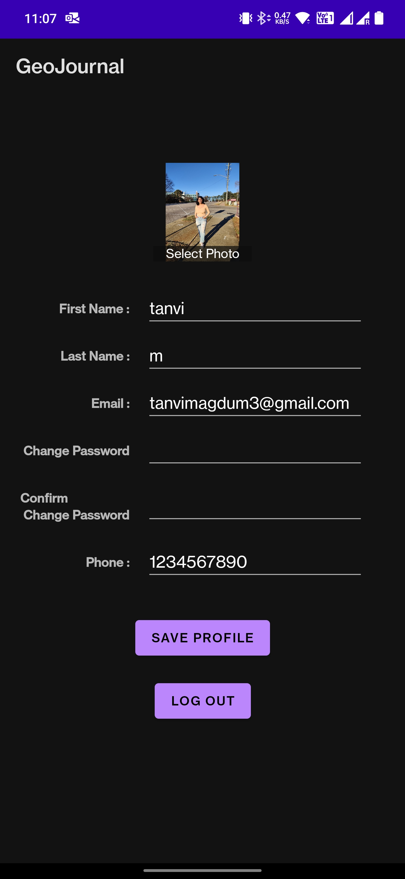
Profile

Slide 11
Profile
User can access their profile by clicking on the My profile button on the Landing Page.
Profile activity pops up and displays all the info about the user. All the text view fields are editable except for the email id which is non-changeable.
User can modify their password, name, phone number or even upload a profile photo by clicking on the image view “Select Photo”. Note that current password would not be visible due to security reasons.
Save profile will save the fields which are edited.
User can log out of the account by clicking on Logout button here.

Slide 12
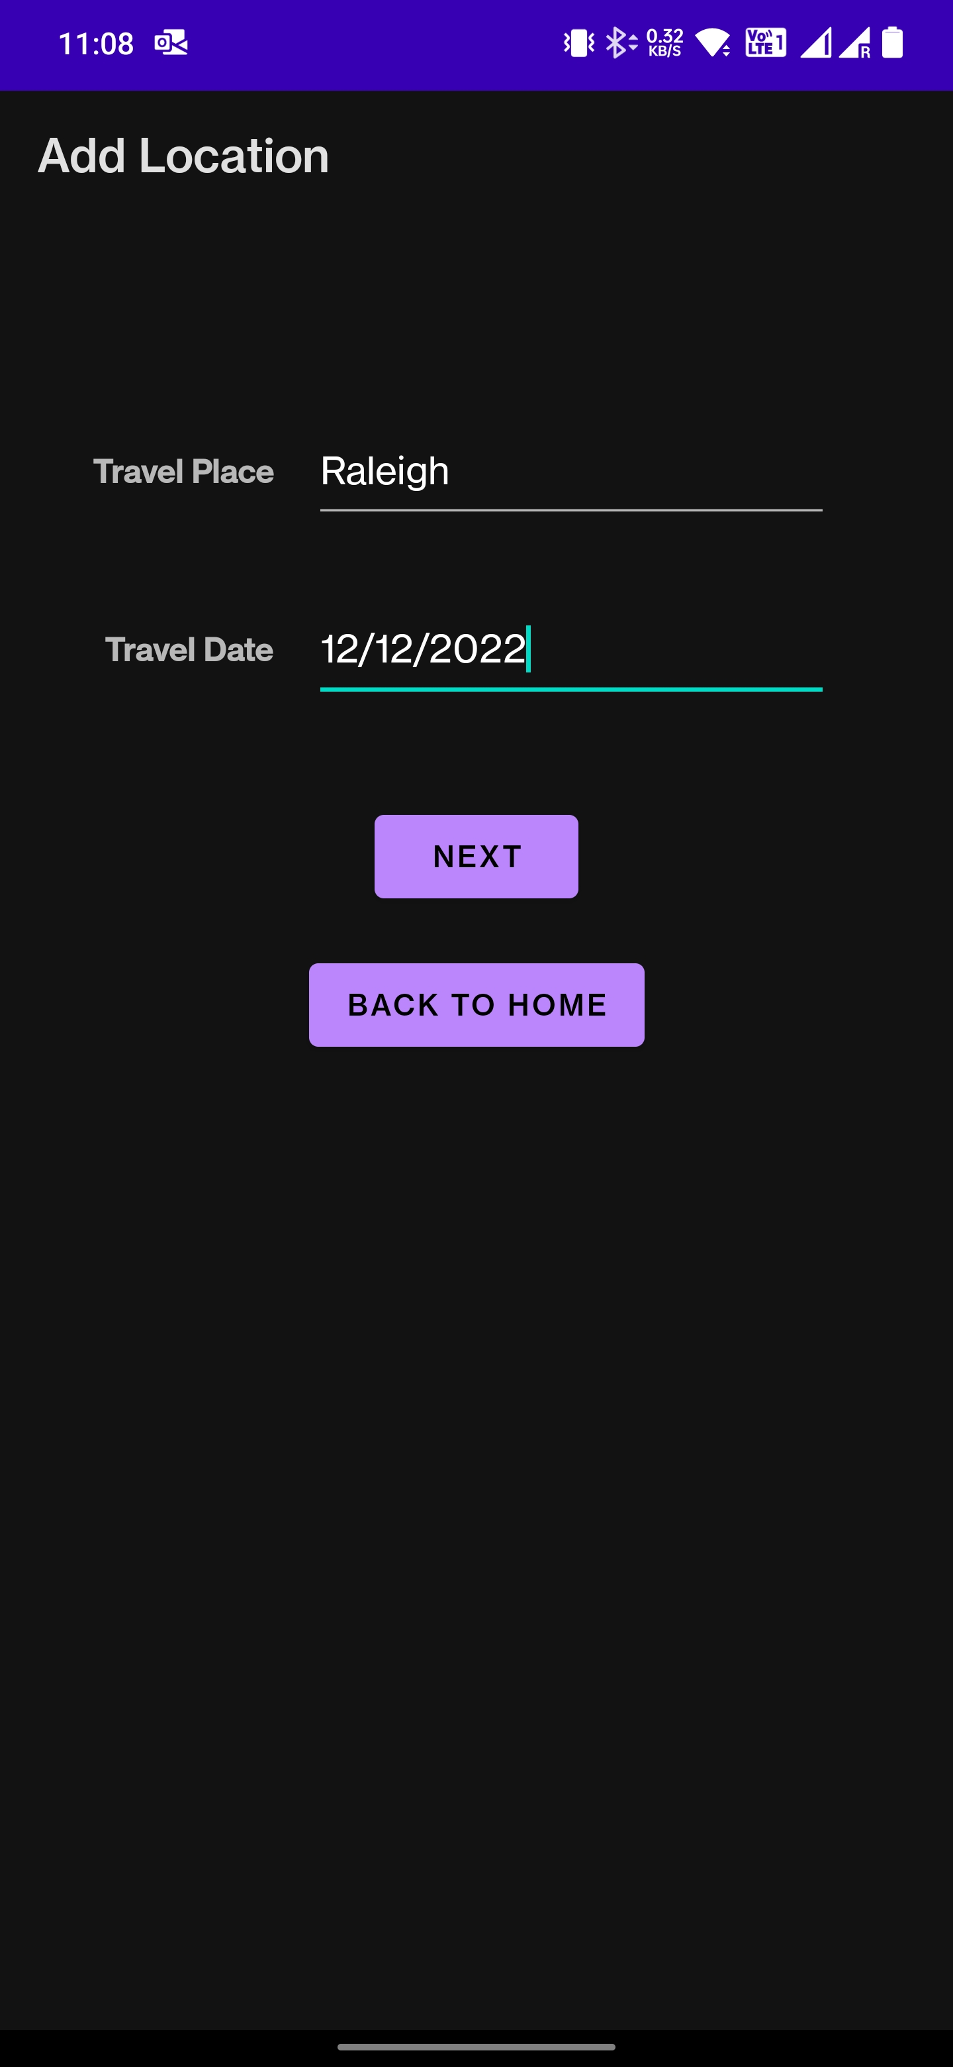
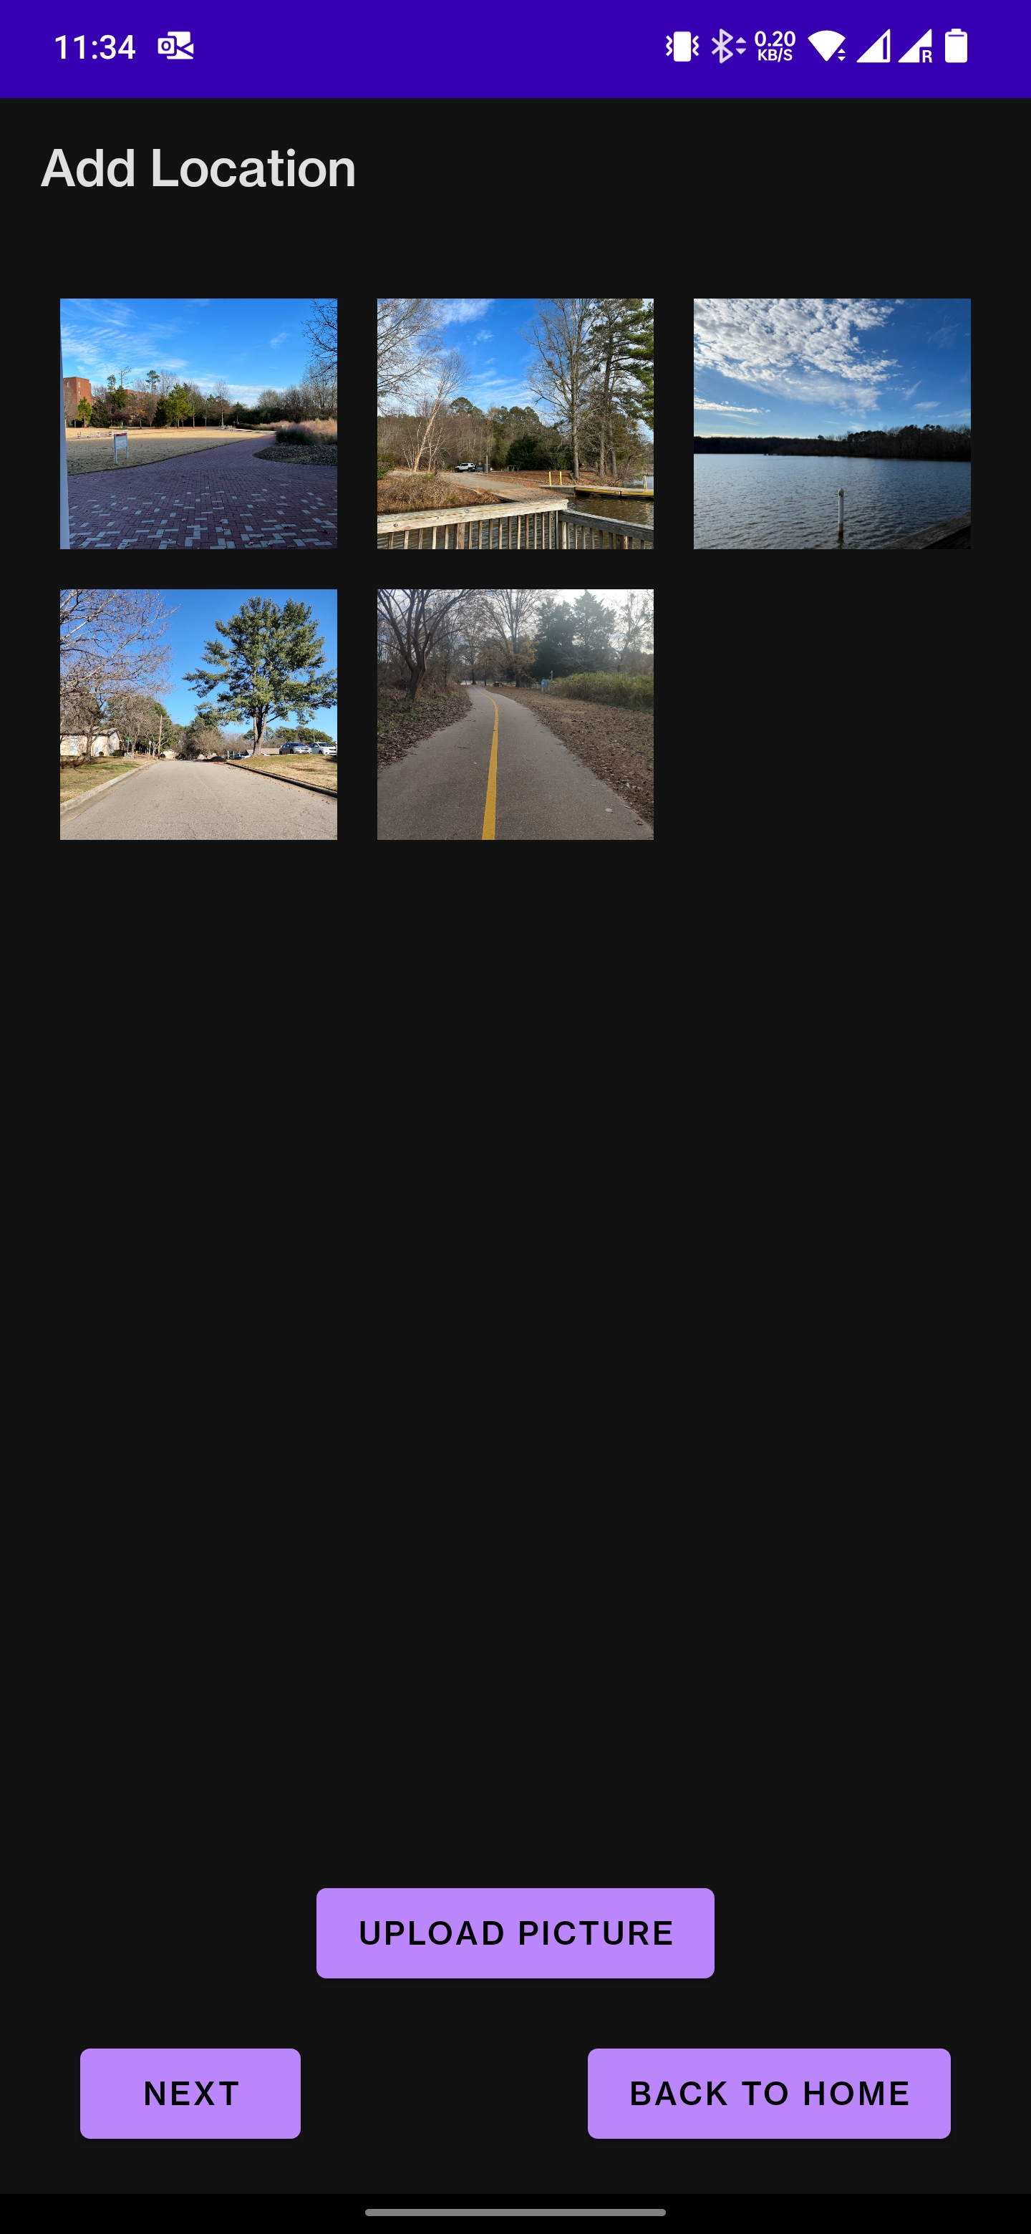
Adding Information

Slide 13
Adding Information
This activity is popped up after clicking on the add location button on the Landing Page.
On first page, user has to enter traveled place and date. Both fields are madatory. Click on Next.
User can now tag photos by clicking Upload Picture, either by taking a photo from the camera or through the file system (gallery). The images would be displayed in a grid fashion in a recycler view.
Also, there is Back to Home button on every screen of this flow. User can quit the flow and navigate back to the Home screen/Maps view, but the information entered till that point would not be saved.

Slide 14
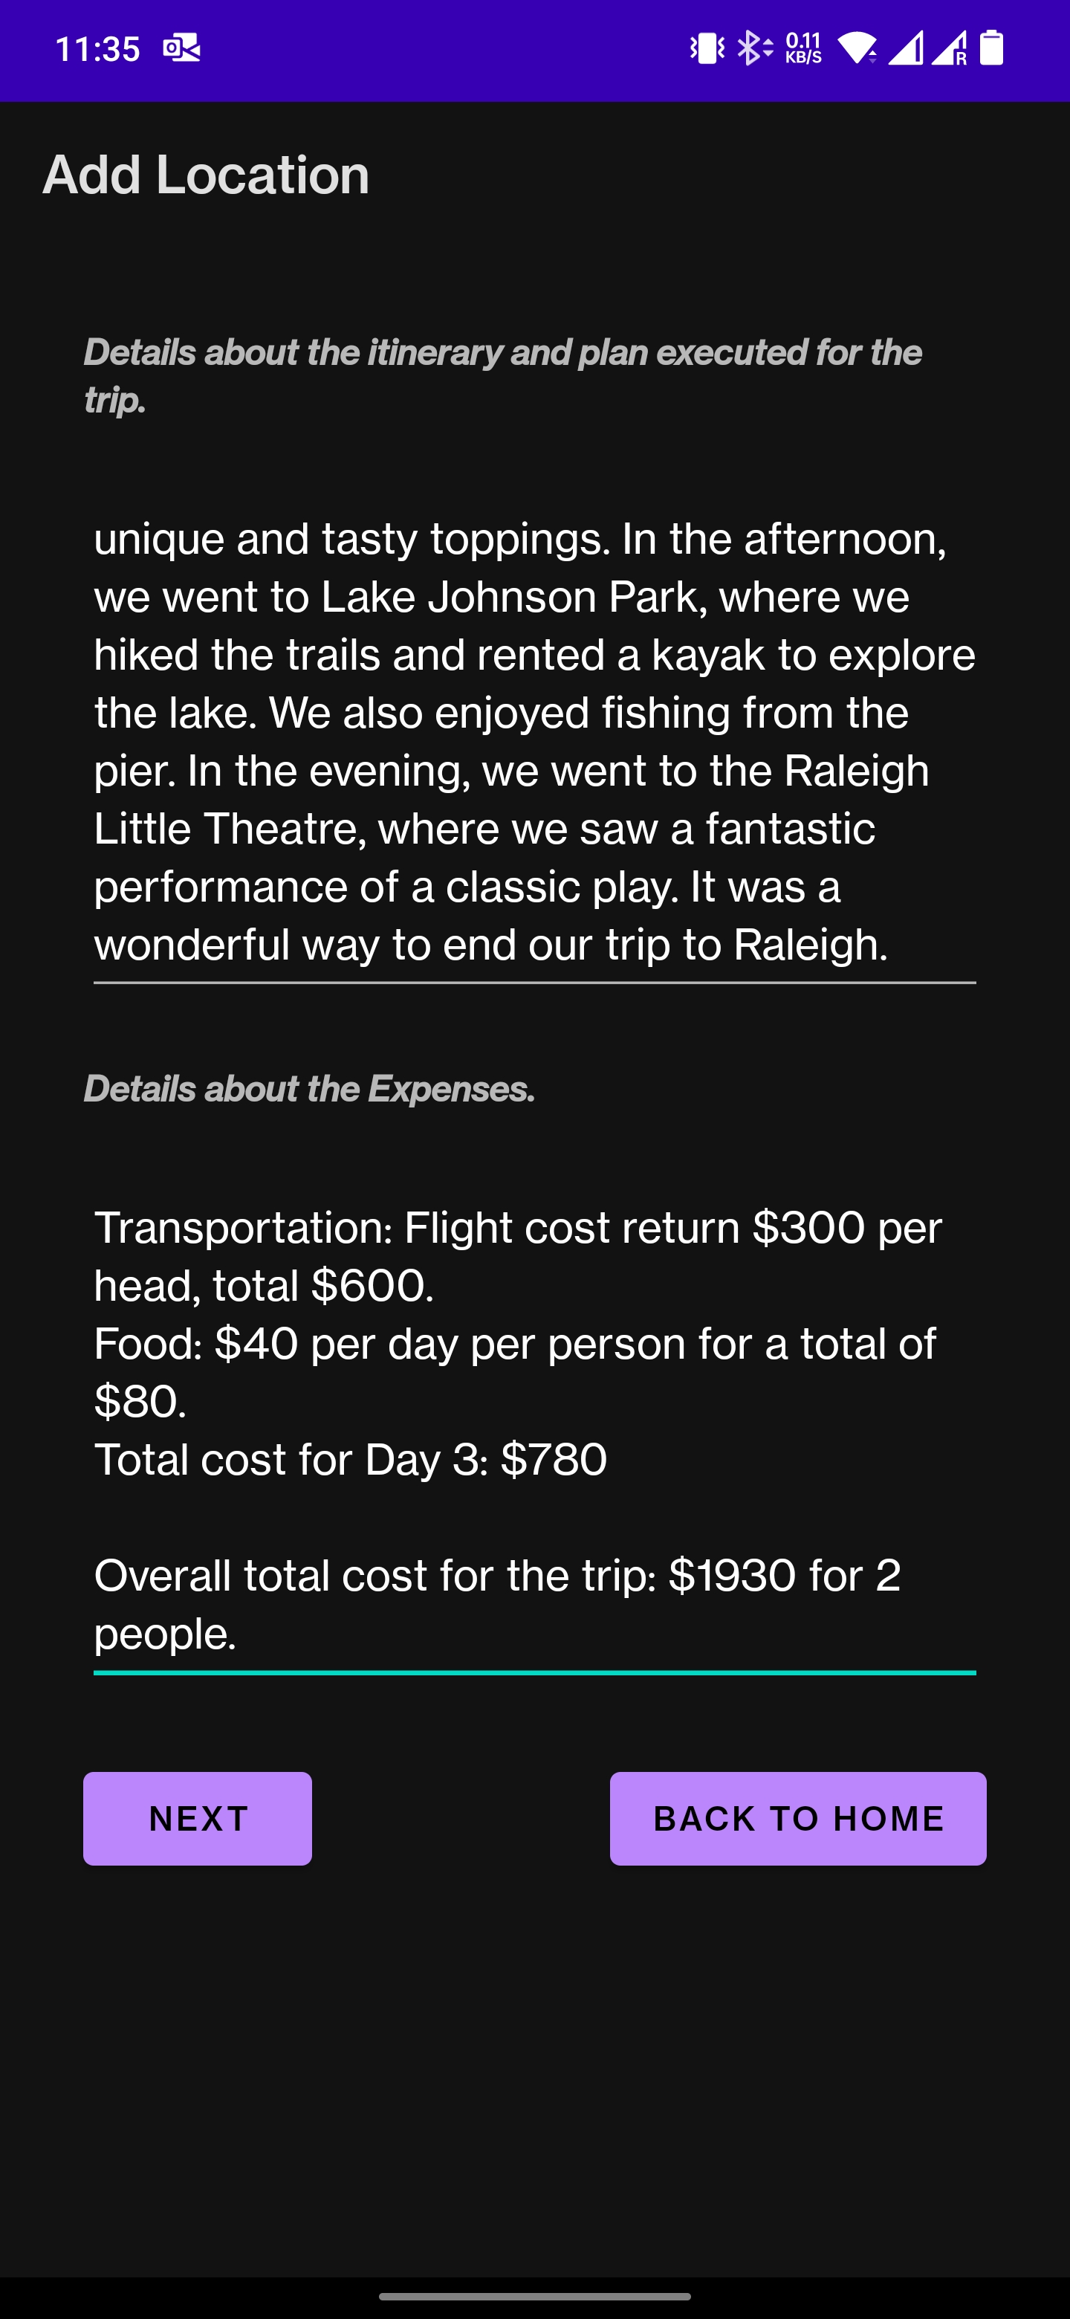
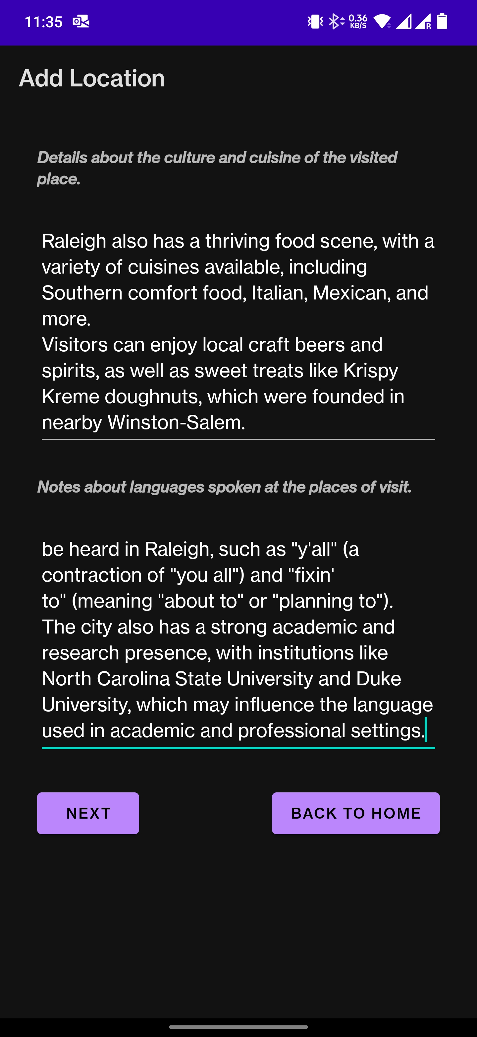
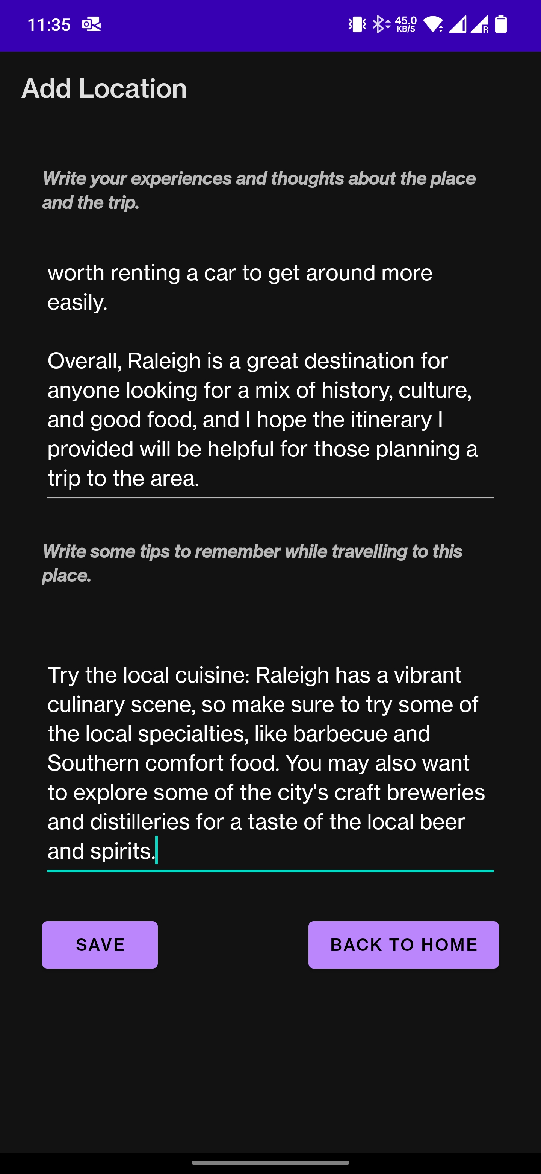
Adding Information

Slide 15
Adding Information
After adding photos, multiline edit-text views are provided where user can enter itinerary and expense of trip, culture, cuisine, language of the place visited and user's experiences and any travel tips. User can also paste the information from different source in these textboxes. (Emulators might not allow this, but it is possible in applications on Android phone).
After adding all the information user has to click Save button to save the information to firebase. User can choose Back to Home to cancel the whole upload. Successful upload takes the user back to the landing page where the details are already updated.

Slide 16
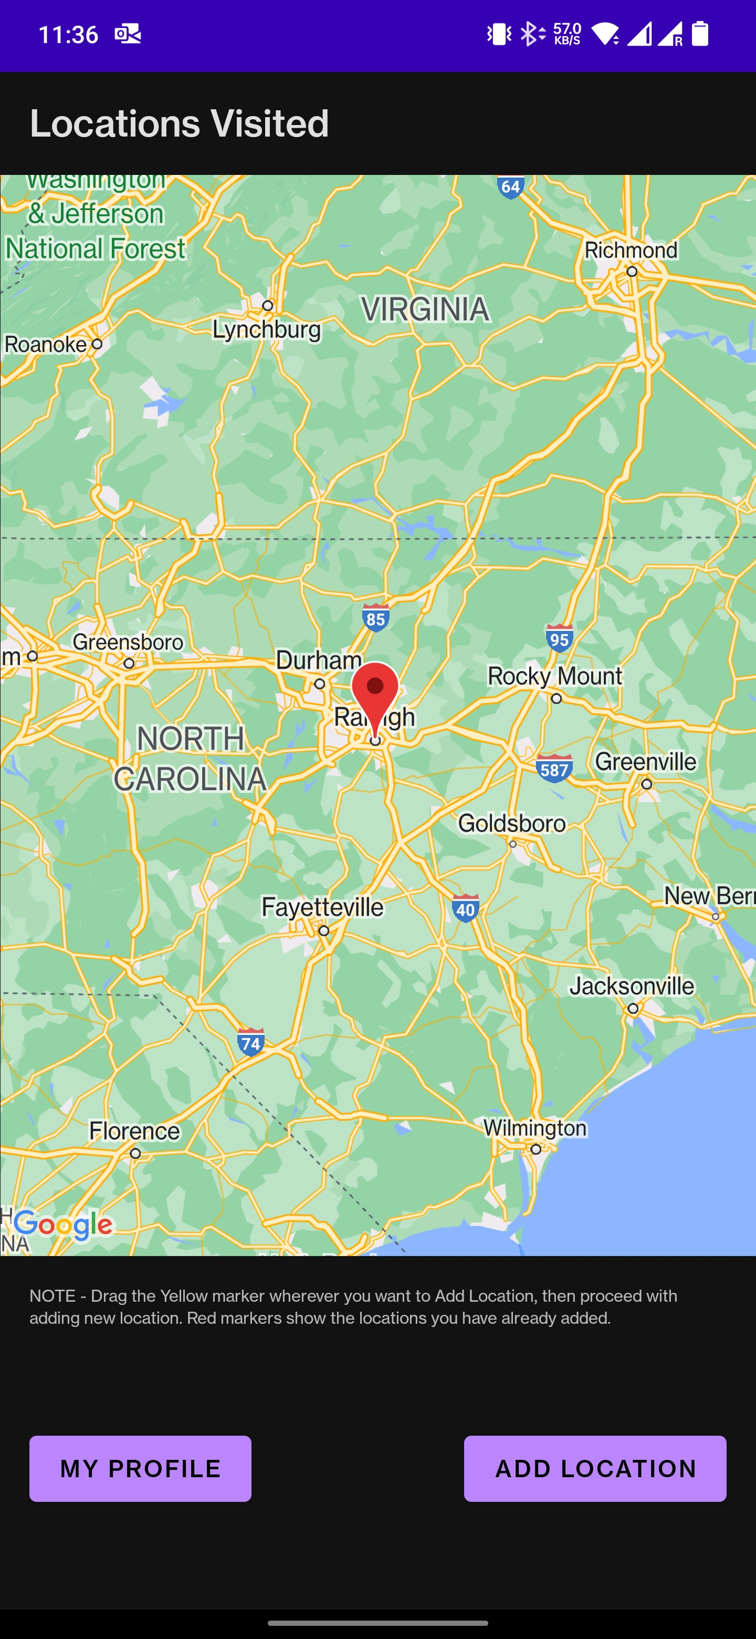
Map After Adding Information

Slide 17
Map After Adding Information
Once the information is saved, user gets a Toast message likewise and is directed back to the maps view or Landing Page.
A red marker is dropped at the position where user choosed to place the yellow marker and upload the information. There could be multiple red markers for a particular user account depending upon the number of travel places he has saved. These markers are clickable but non-draggable.

Slide 18
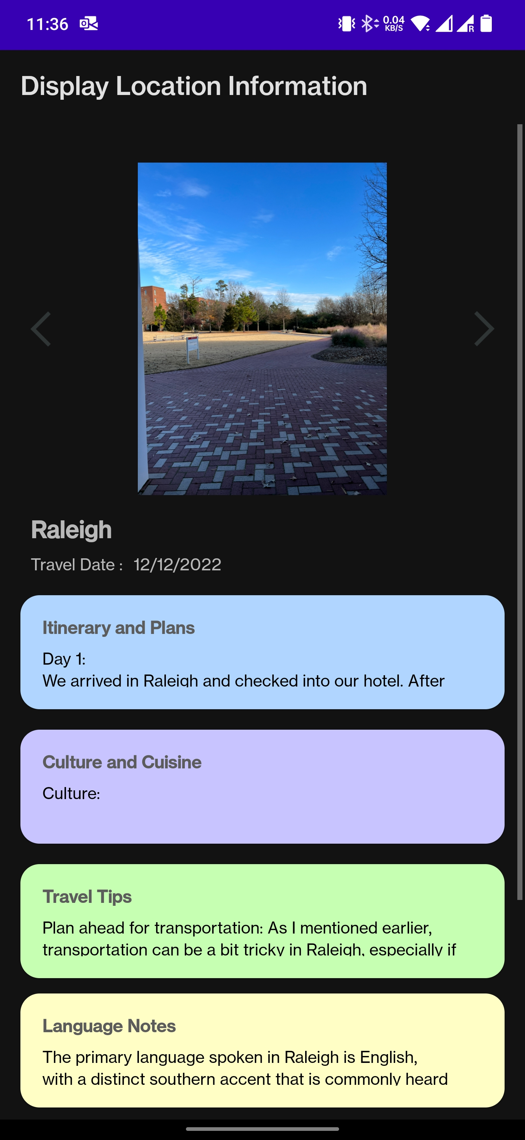
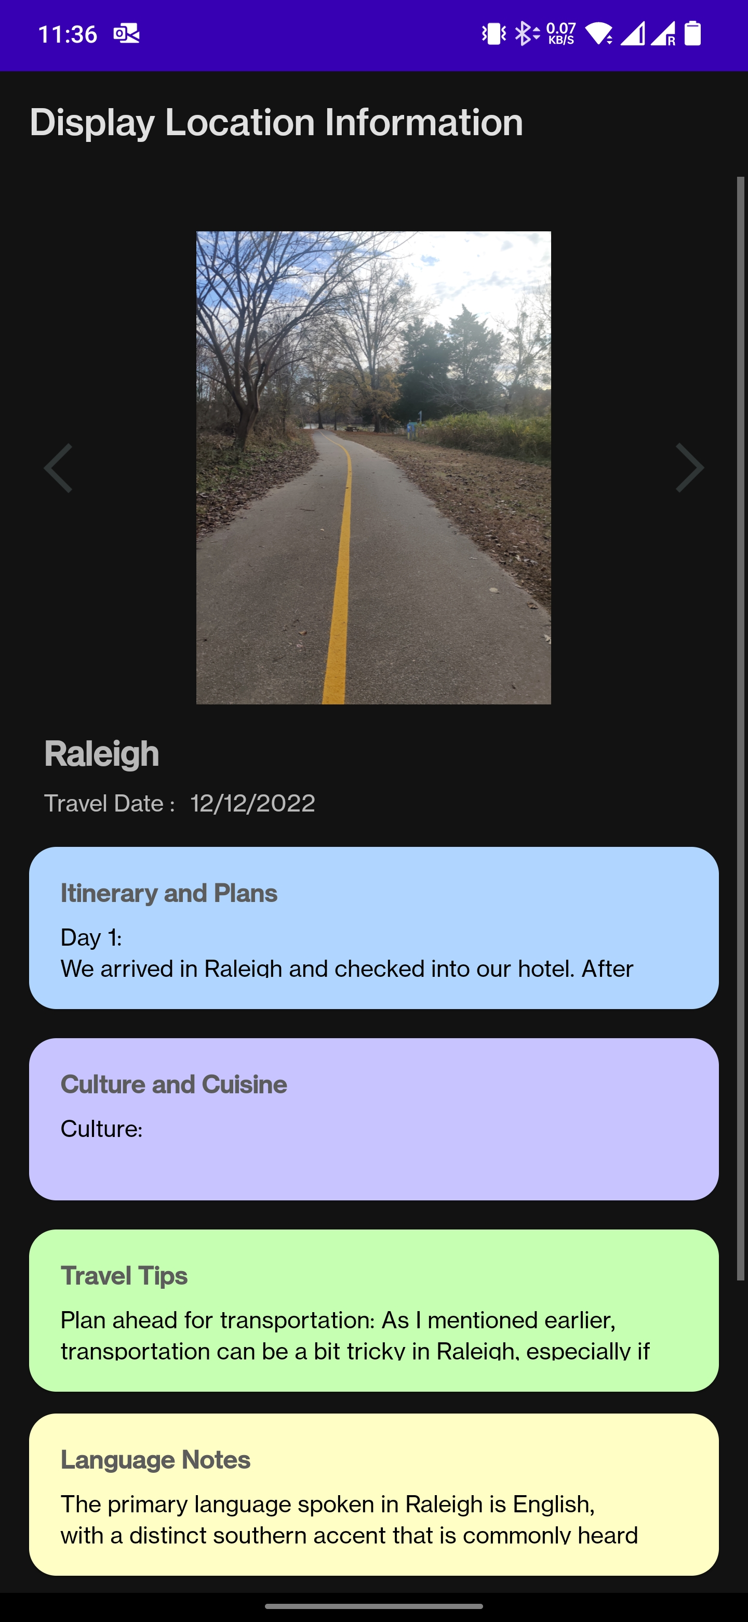
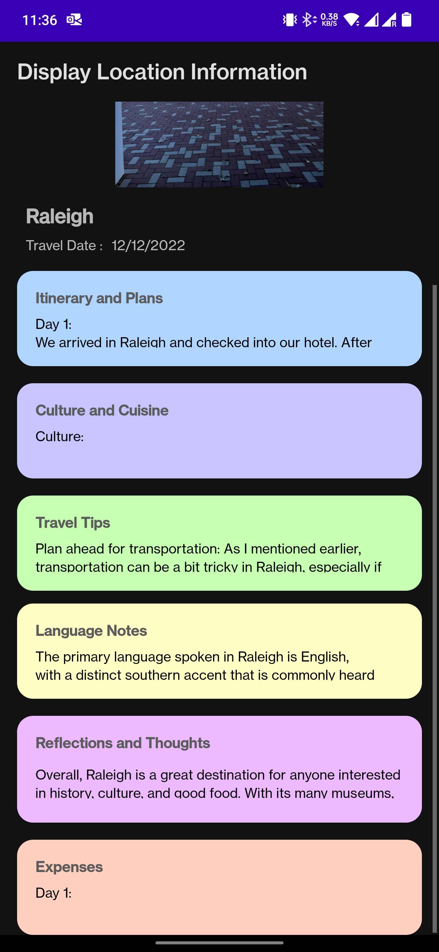
Revisiting/Display Information

Slide 19
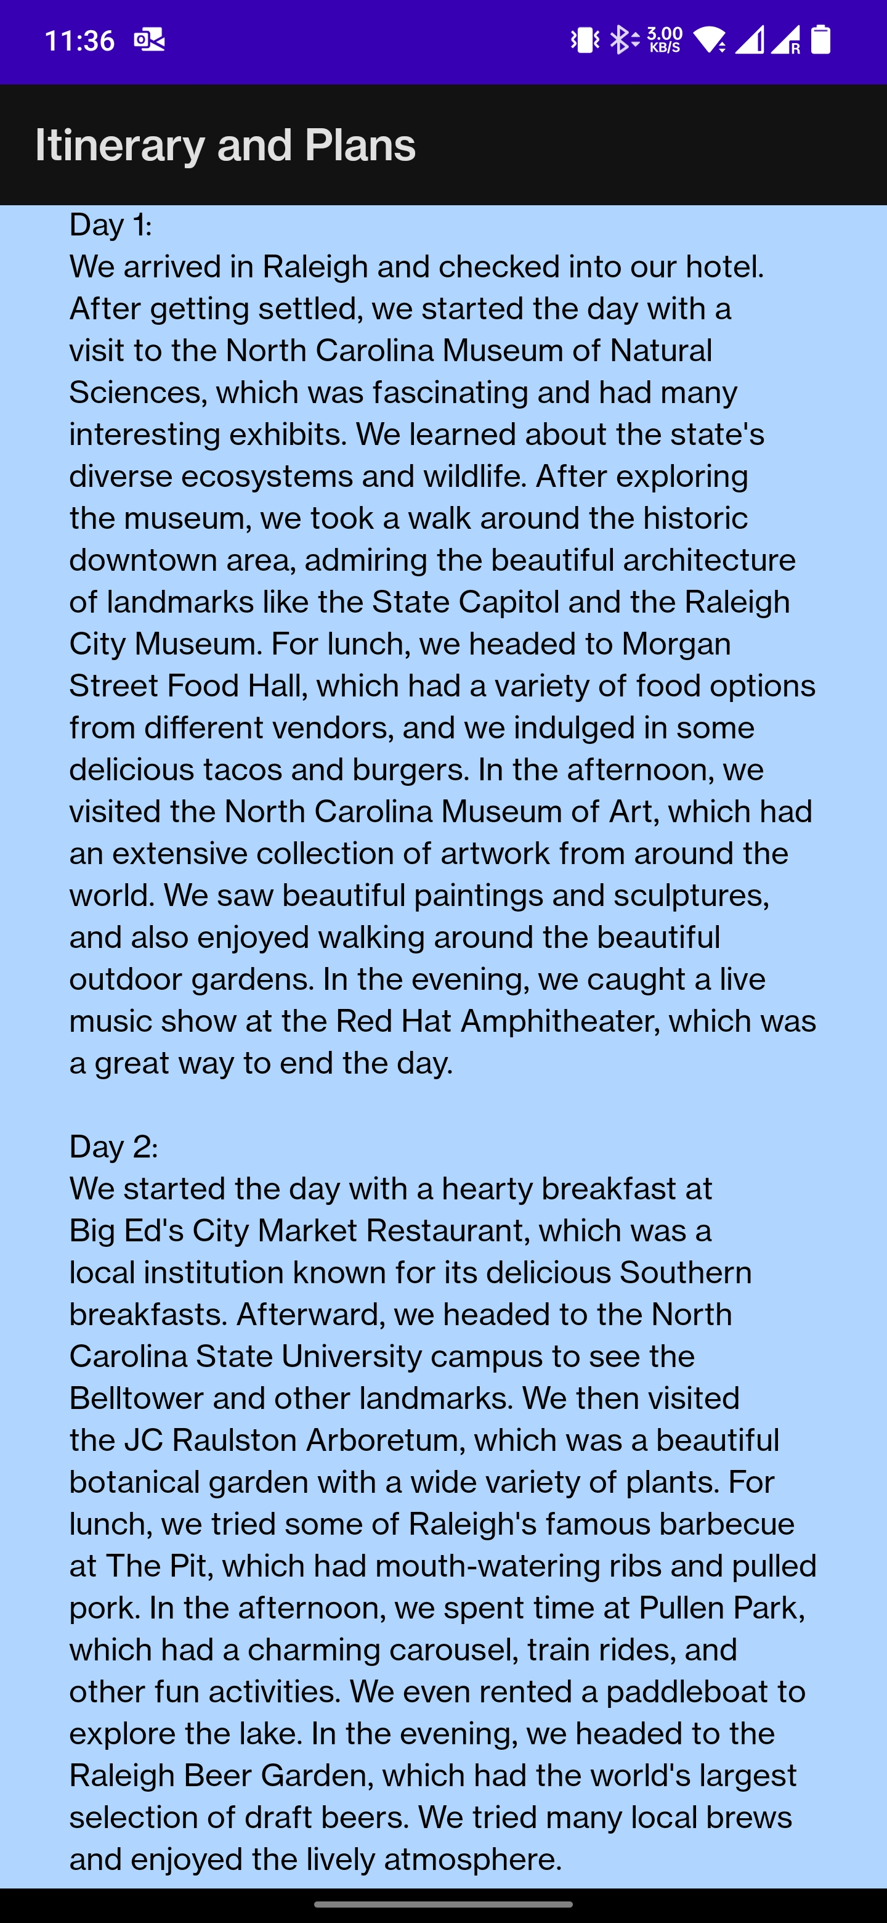
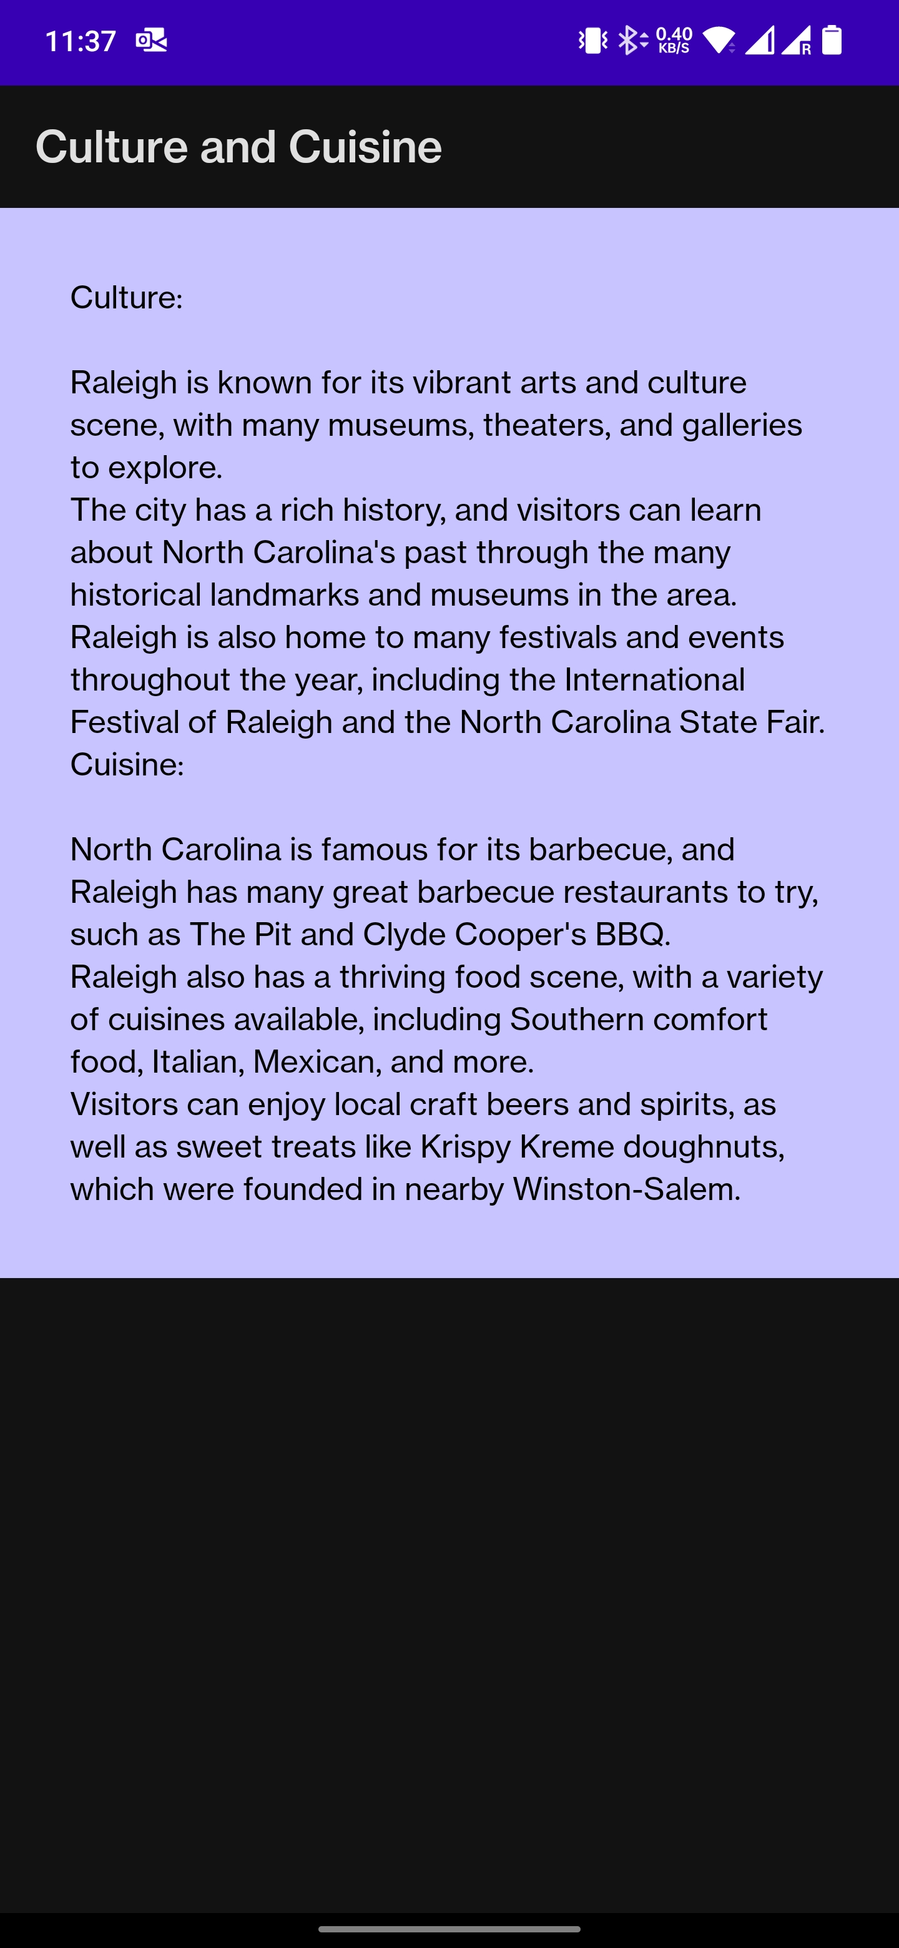
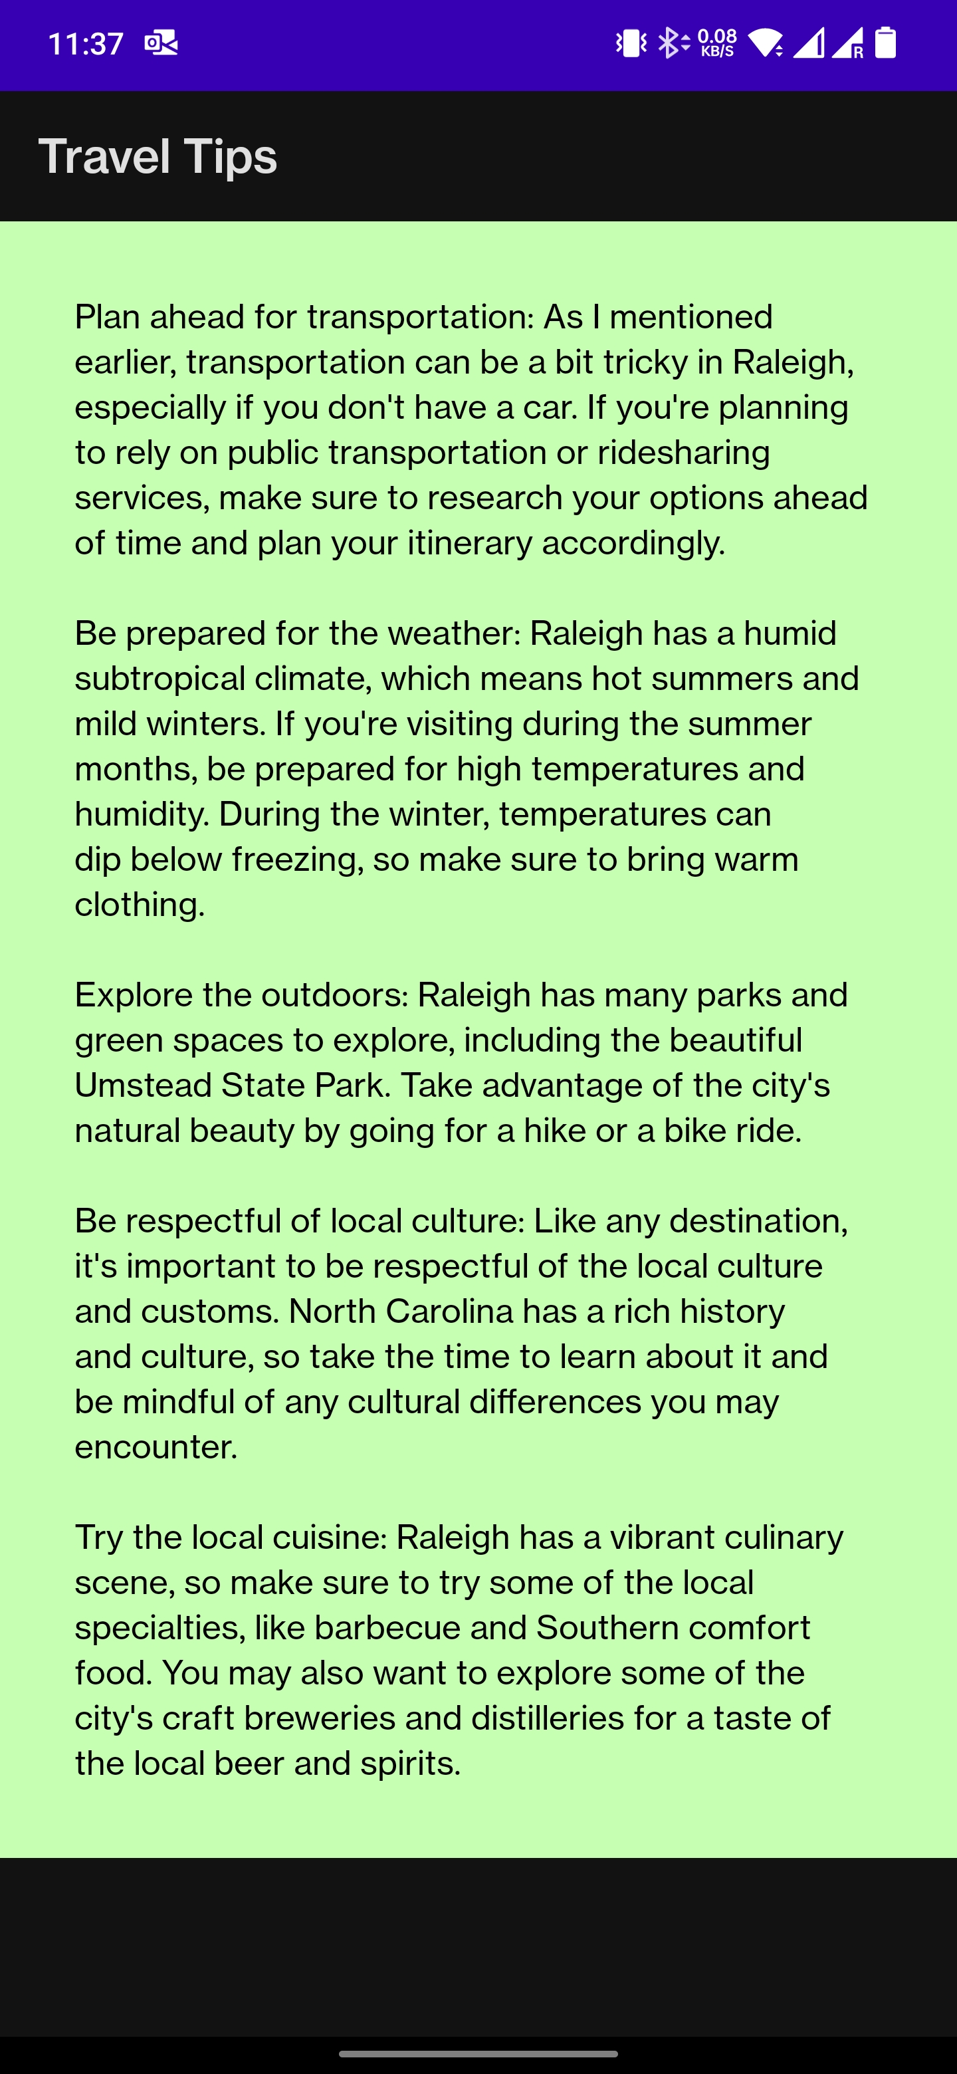
Display Information : Expanded Views

Slide 20
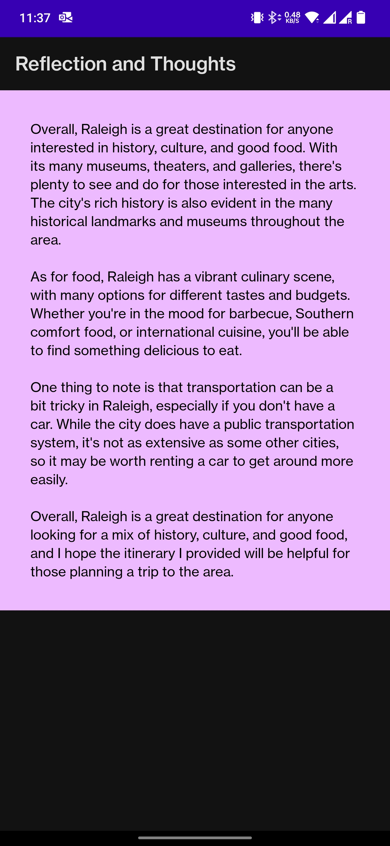
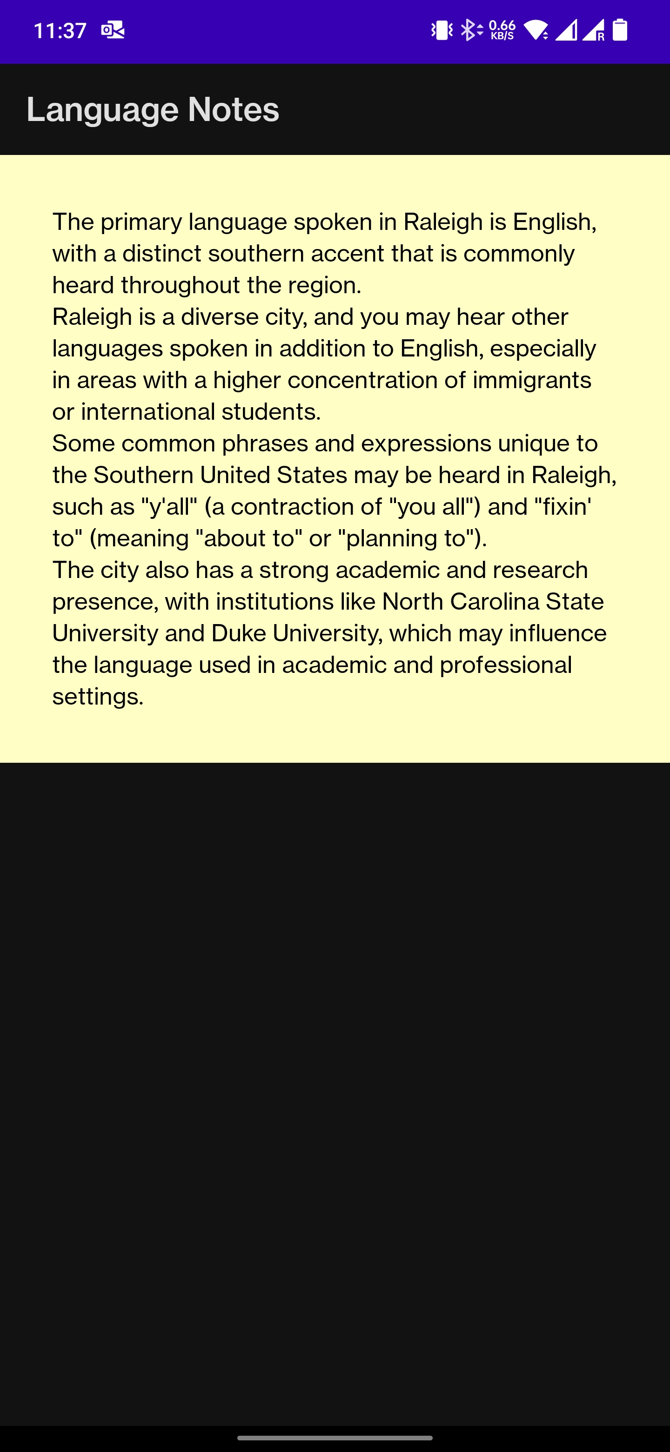
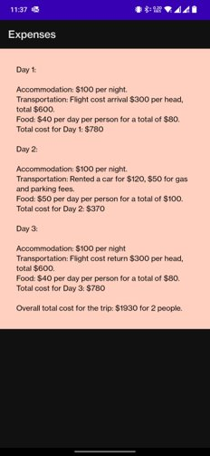
Display Information : Expanded Views Contd.

Slide 21
Display Information
By clicking on the red markers on the landing page, user can view the information that is tagged to that specific location.
Images are displayed at top, with next and previous buttons. If there is only one image, next and previous buttons and not visible.
The screen is scrollable and there is a CardView of different color for each category. The textView in it has a limited height and trims the information. The CardViews are clickable and they expand the information from the textView.

